Slide 1



DEPARTMENT OF MATHEMATICS
“INTRODUCTION TO
BINARY COMPOSITION”
Presented by
Prithwis Dey
Reg:
115-1111-0493-19
Roll:
193115-21-0105
Sem:
02
Col.Roll:
43

Slide 2

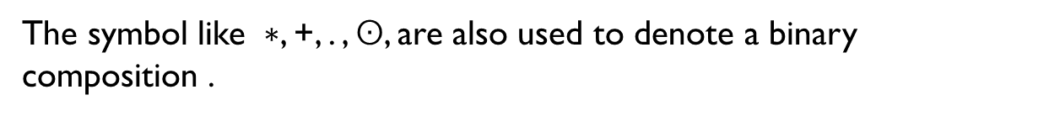
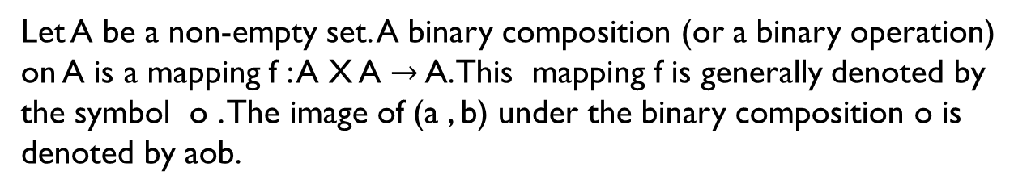
Binary Composition
Definition :-
Let A be a non-empty set. A binary composition (or a binary operation) on A is a mapping f : A X A $→$ A. This mapping f is generally denoted by the symbol o . The image of (a , b) under the binary composition o is denoted by aob.
The symbol like $∗$, +, . , $ʘ$, are also used to denote a binary composition .
Examples :
(1) On the set Z let o stand for the binary composition ‘addition’. Then 2o3 = 5,
(2) On the set Z let o stand for the binary composition ‘multiplication’.
(3) On the set Z let o stand for the binary composition ‘subtraction’.

Slide 3

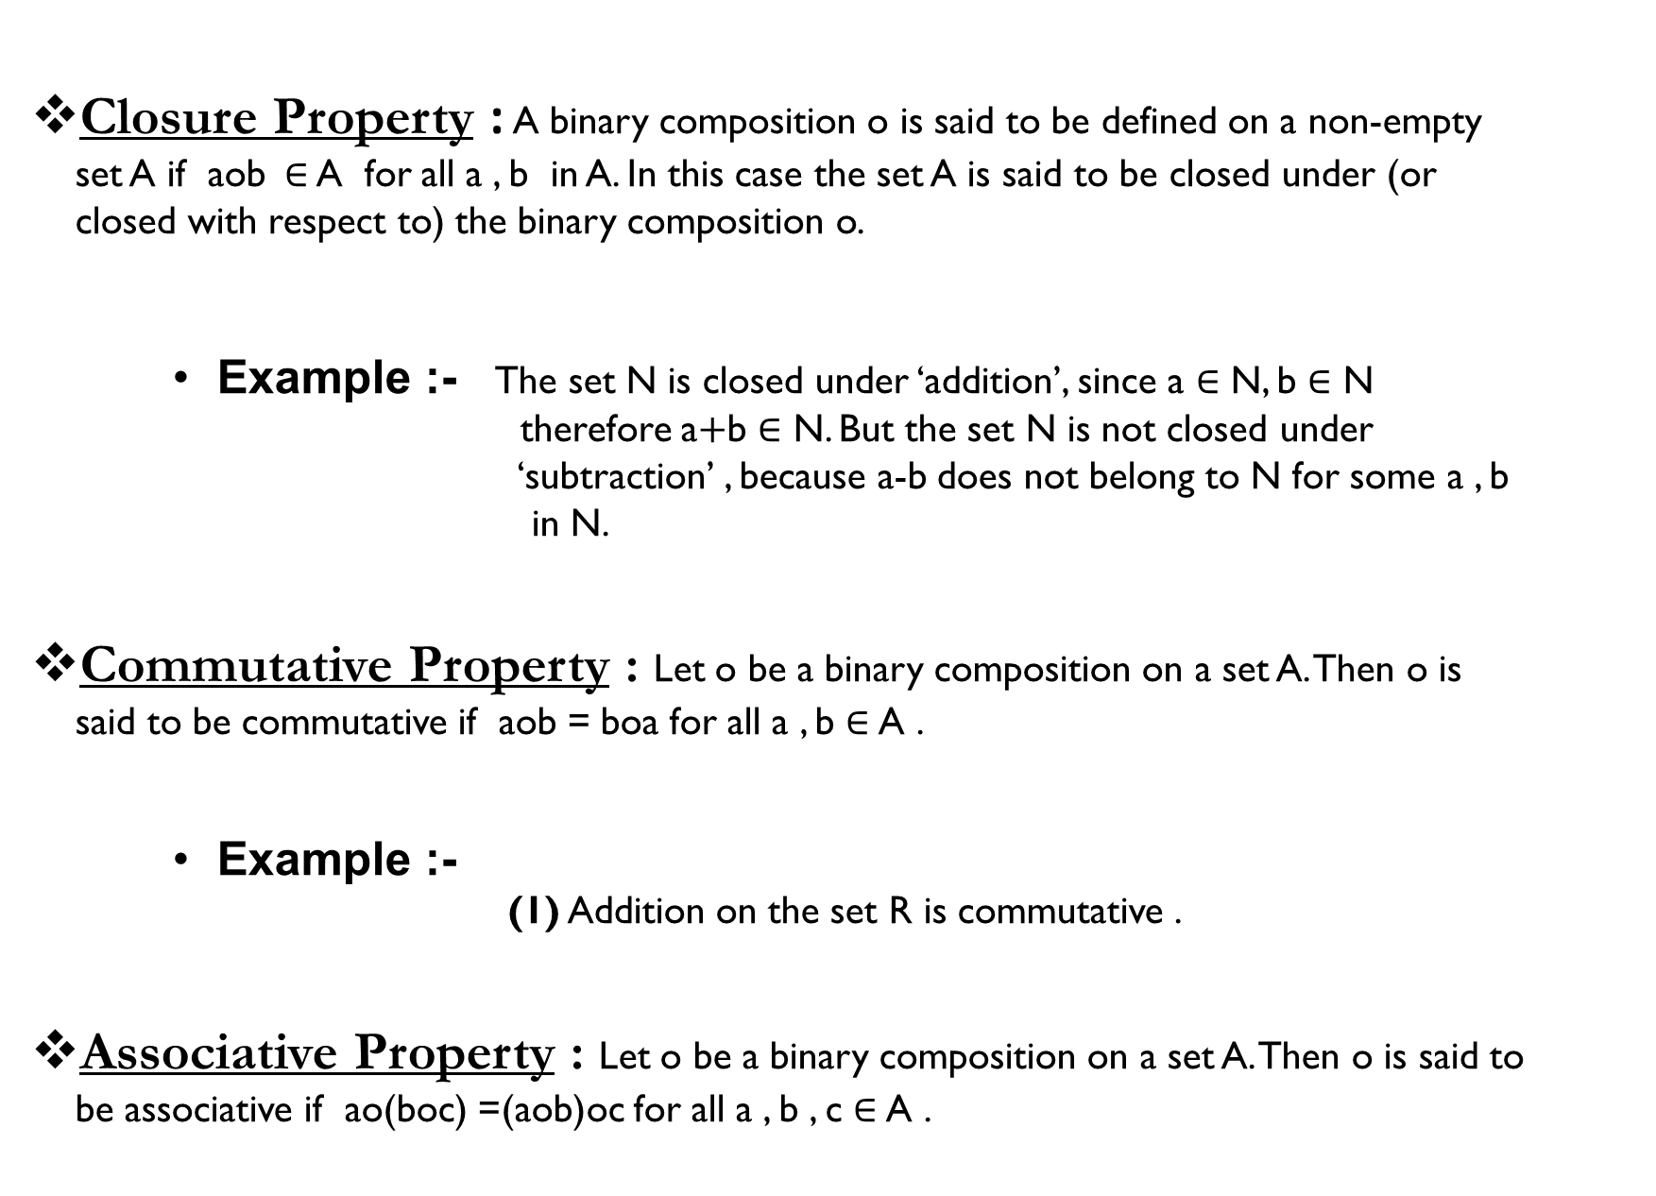
Properties :
Closure Property : A binary composition o is said to be defined on a non-empty set A if aob $∈$ A for all a , b in A. In this case the set A is said to be closed under (or closed with respect to) the binary composition o.
    Example :- The set N is closed under ‘addition’, since a $∈$ N, b $∈$ N therefore a$+$b $∈$ N. But the set N is not closed under ‘subtraction’ , because a-b does not belong to N for some a , b in N.
Commutative Property : Let o be a binary composition on a set A. Then o is said to be commutative if aob = boa for all a , b $∈$A .
    Example :-
    (1) Addition on the set R is commutative .
Associative Property : Let o be a binary composition on a set A. Then o is said to be associative if ao(boc) =(aob)oc for all a , b , c $∈$A .

Slide 4


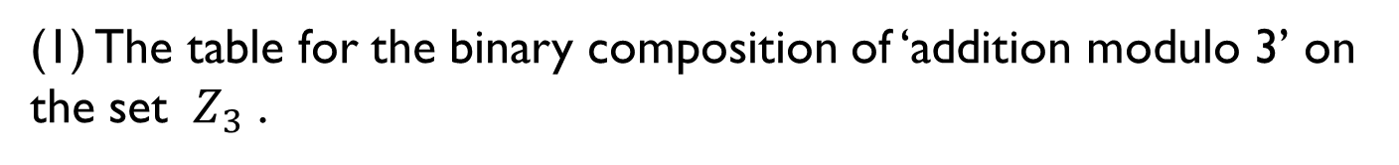


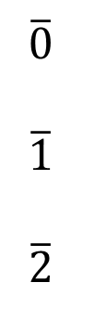

    Examples :-
    (1) Addition on the set R is associative .
        (2) Multiplication on the set R is associative .
        (3) Subtraction on the set R is not associative .
Composition Table :
When A is a non-empty finite set a binary composition o on the set A can be defined by a table , called the composition table .
Example :-
(1) The table for the binary composition of ‘addition modulo 3’ on the set ${ Z}_{3}$ .
Answer :
+
$\overline{0}$ $\overline{1}$ $\overline{2}$
$$\overline{0}$$
$$\overline{1}$$
$$\overline{2}$$
$\overline{1}$ $\overline{2}$ $\overline{0}$
$\overline{0}$ $\overline{1}$ $\overline{2}$
$\overline{2}$ $\overline{0}$ $\overline{1}$
$∴$ Here the composition is commutative .

Slide 5

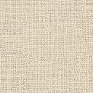
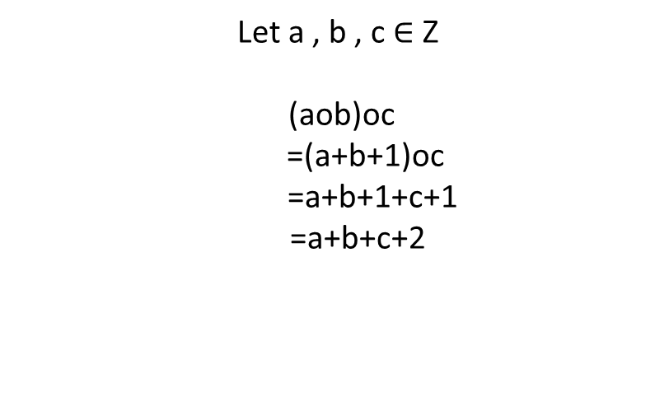

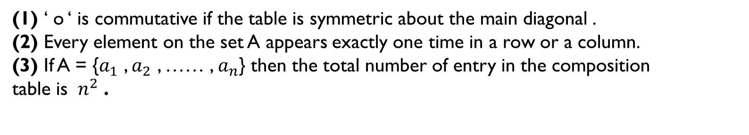
Notes :
(1) ‘ o ‘ is commutative if the table is symmetric about the main diagonal .
(2) Every element on the set A appears exactly one time in a row or a column.
(3) If A = {$a_{1}$ , $a_{2}$ , …… , $a_{n}$} then the total number of entry in the composition table is ${ n}^{2}$ .
Exercise :
Examine whether the composition o defined on the set is
(i) Commutative(ii) Associative .
Answer :
(a)
Given, aob = a+b+1 , a , b $∈$ Z .
(i) Associative :
Let a , b , c $∈$ Z
(aob)oc
=(a+b+1)oc
=a+b+1+c+1
=a+b+c+2
Now,
Again,
ao(boc)
=ao(b+c+1)
=a+b+c+1+1
=a+b+c+2

Slide 6

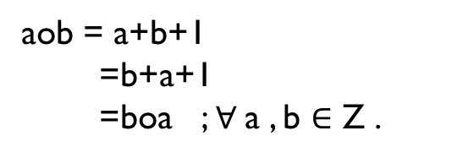


Therefore,
(aob)oc = ao(boc) ; $∀$a , b , c $∈$ Z
So, ‘ o ‘ is commutative on Z.
(ii) Commutative :
a, b $∈$ Z
Now,
aob = a+b+1
=b+a+1
=boa ; $∀$a , b $∈$ Z .
So, ‘ o ‘ is commutative on Z .
Definitions :
Groupoid :
Let G be a non-empty set on which a binary composition o is defined . The algebraic system (G , o) is said to be a groupoid .
Example :
(Z,$+$) , (Z,$−$) , (Q,$+$) , (R,$+$) , (Q, .) , (R, .) are all groupoids .
Identity Element :
An element e in G is said to be an identity element in the groupoid (G,o) if aoe = eoa for all a in G .

Slide 7


Commutative Groupoid :
A groupoid (G, o) is said to be a commutative groupoid if the binary composition o is commutative.
Examples :
(Z, $+$) is a commutative groupoid .
Right Identity :
An element e in G is said to be a right identity in the groupoid (G,o) if aoe = a for all a in G .
Left Identity :
An element e in G is said to be a left identity in the groupoid (G,o) if eoa = a for all a in G .
Invertible :
An element a in G is said to be invertible if there exists an element a’ in such that a’oa = aoa’ is said to be an inverse of a in the groupoid.
Left Invertible :
An element a in G is said to be left invertible if there exists an element b in G such that boa = e.

Slide 8

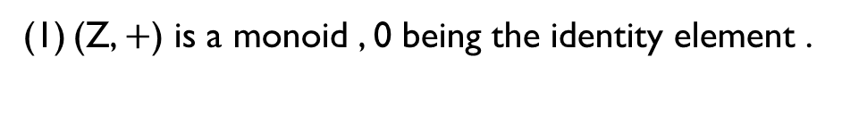
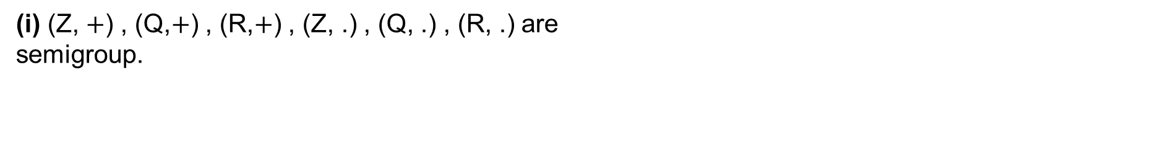
Right Invertible :
An element a in G is said to be right invertible if there exists an element c in G such that aoc = e.
Semigroup :
A groupoid (G, o) is said to be a semigroup if the binary composition o is associative .
Example :
(i) (Z, $+$) , (Q,$+$) , (R,$+$) , (Z, .) , (Q, .) , (R, .) are semigroup.
Commutative Semigroup :
A semigroup (G, o) is said to be a commutative semigroup if the binary composition o is commutative .
Example :
($Z_{n}$ , .) is a commutative group.
Monoid :
A semigroup (G, o) containing the identity element is said to be a monoid .
Example :
(Z, $+$) is a monoid , 0 being the identity element .

Slide 9

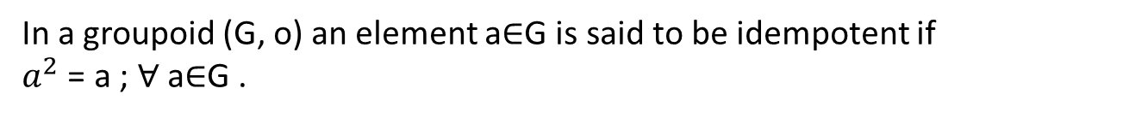
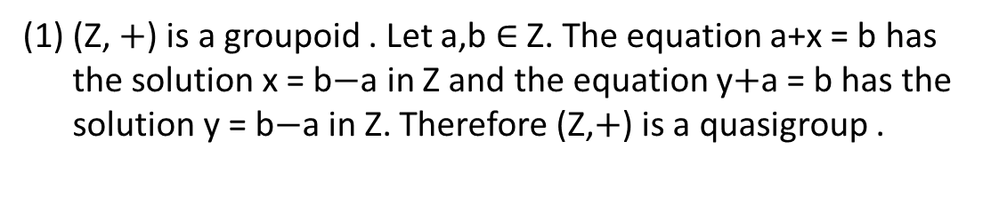
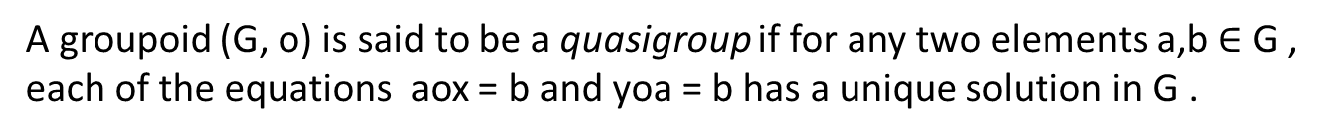
Commutative Monoid :
A monoid (G, o) is said to be a commutative monoid if o be commutative .
Unit :
In a monoid an invertible element is said to be a unit .
Idempotent Element:
In a groupoid (G, o) an element a$∈$G is said to be idempotent if
$a^{2}$ = a ; $∀$ a$∈$G .
Quasigroup :
A groupoid (G, o) is said to be a quasigroup if for any two elements a,b $∈$ G , each of the equations aox = b and yoa = b has a unique solution in G .
Example :
(Z, $+$) is a groupoid . Let a,b $∈$ Z. The equation a+x = b has the solution x = b$−$a in Z and the equation y$+$a = b has the solution y = b$−$a in Z. Therefore (Z,$+$) is a quasigroup .

Slide 10

ACKNOWLEDGEMENT
I would like to express my special thanks of gratitude to my mentor Dr. Netai Roy who gave me the golden opportunity to do this wonderful presentation on the topic “ Binary Composition”.
REFERENCE:
(1) HIGHER ALGEBRA ABSTRACT AND LINEAR.
(2) WIKIPEDIA.
Thank you

